Slide 1

The UPIKE Turnaround: A Data-Driven Approach to Roster Optimization
Predicting Player Efficiency (PEI) to Drive a 5-Year Strategic Turnaround
Magdalena Vicencio
DAT 310
December 8, 2025
Dr.Bang

Slide 2
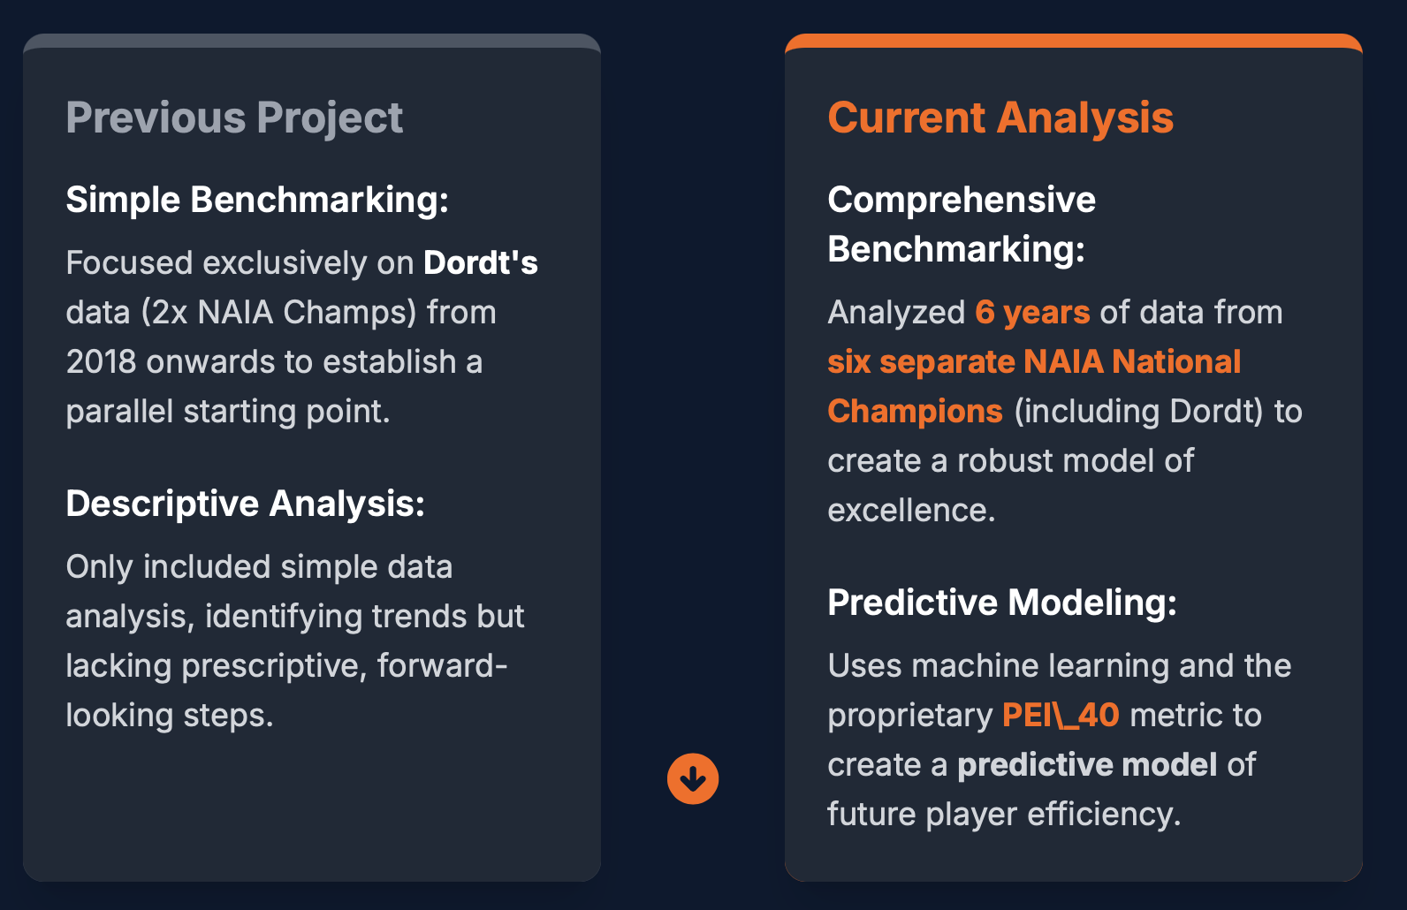
THE OBJECTIVE: A 5-YEAR TURNAROUND
THE CHALLENGE: Evolving the Blueprint

Slide 3

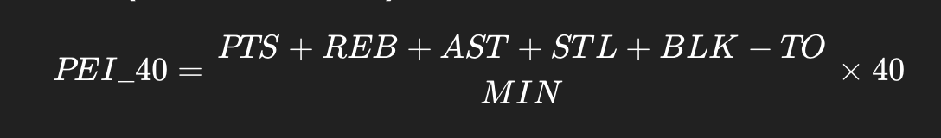
THE GOAL: From Analysis To Action
PEI_40
To move beyond simple statistics and implement a rigorous, data-driven "Moneyball" strategy that leverages predictive modeling and high-impact scenario planning to deliver actionable steps for the UPIKE program's strategic turnaround.
The North Star Metric
Player Efficiency Index per 40 Minutes combines shooting, rebounding, and ball security into a single value.

Slide 4
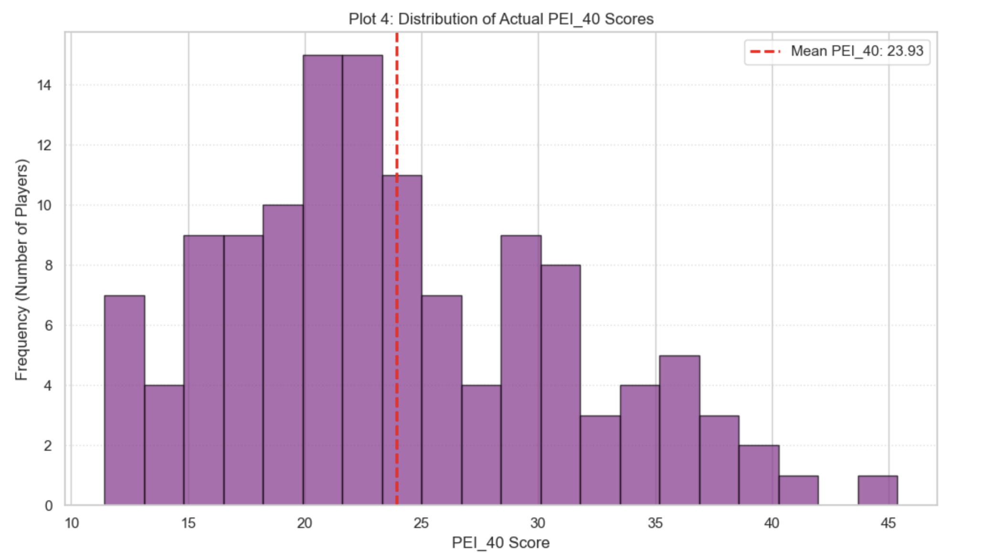

Slide 5






DATA SCIENCE METHODOLOGY
1. PREPARATION
2. SELECTION
3. MODELING
Filtered dataset to players with less than 100 minutes to remove statistical noise. Cleaned missing values and standardized feature scales.
Used Correlation Analysis to identify the "Elite 8" drivers of efficiency, prioritizing rate stats (eFG%) over volume stats.
Implemented Ridge Regression within a leak-proof Pipeline to handle multicollinearity and prevent overfitting.

Slide 6
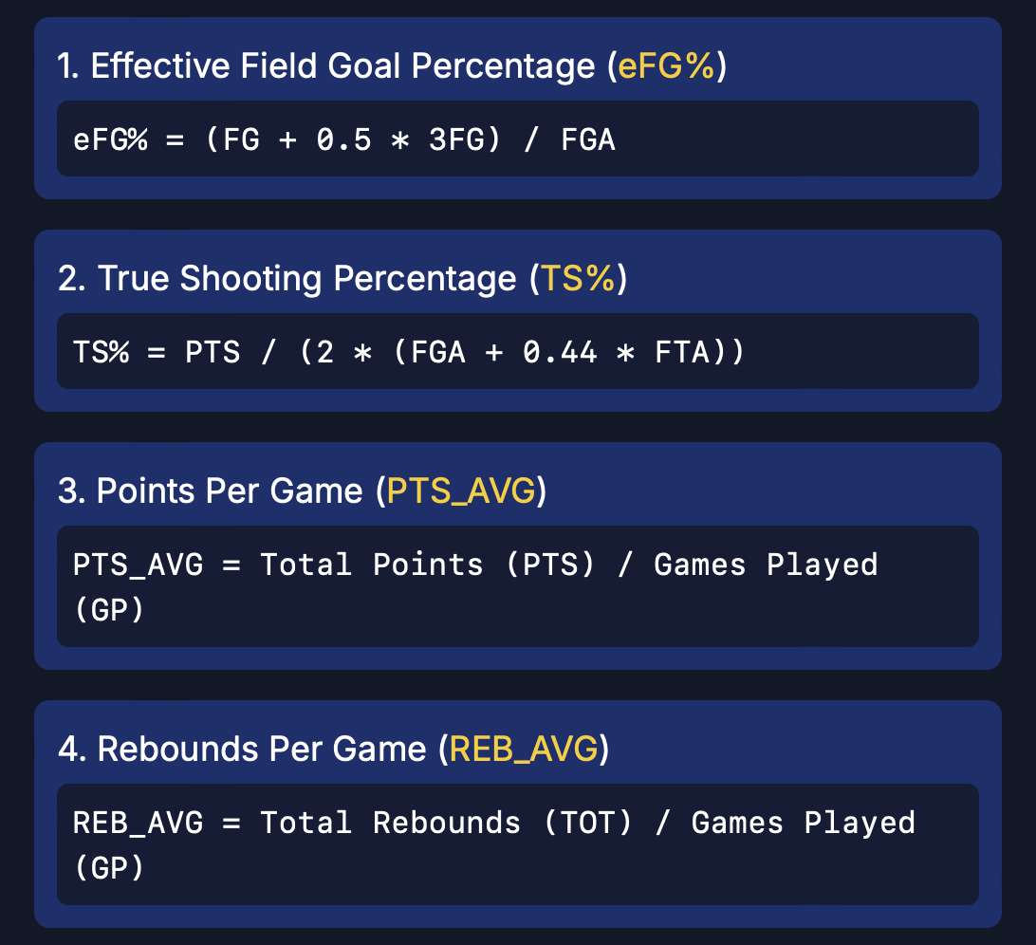
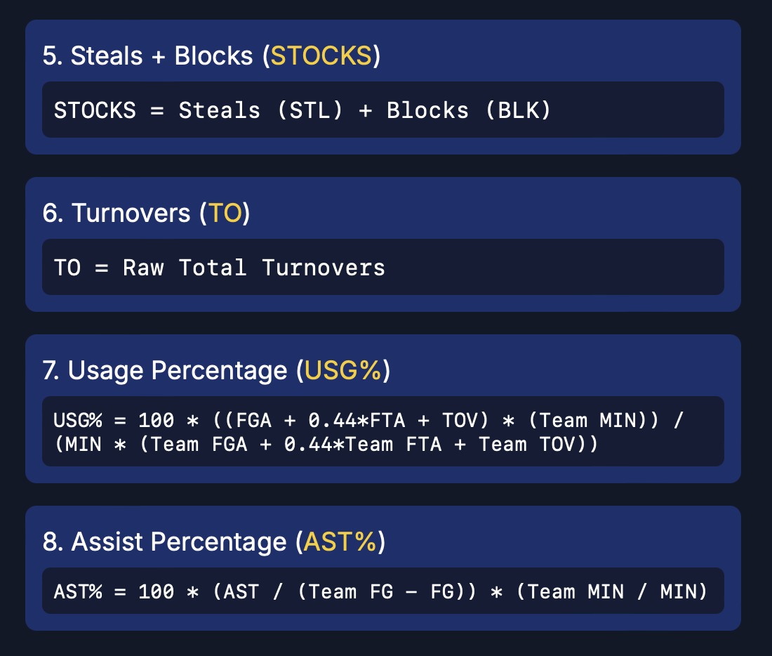
FEATURE SELECTION: FORMULAS

Slide 7
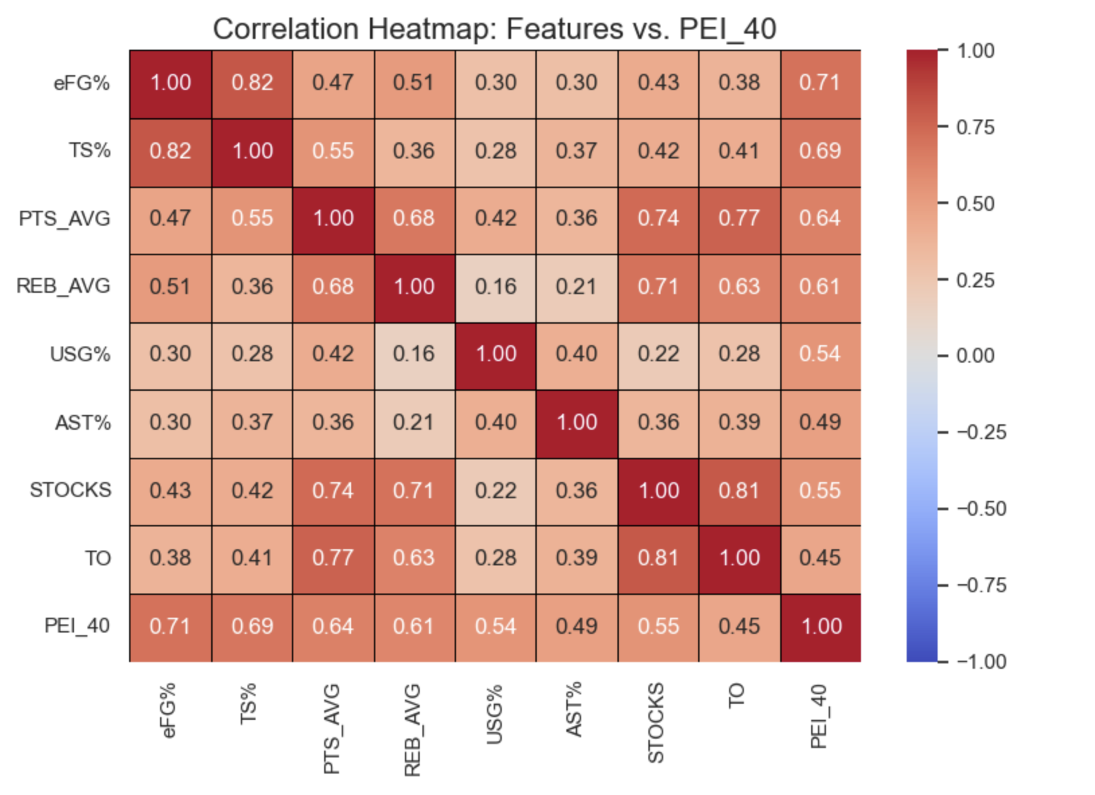

FEATURE SELECTION: THE CORRELATION MATRIX
WHY THESE 8 FEATURES?
>
We analyzed 40 potential metrics.
>
eFG% (0.71) and TS% (0.69) showed the strongest positive correlation with PEI_40.
>
We explicitly included Turnover Rate as a negative volume metric to penalize inefficient play.
>
The heatmap reveals strong clusters around shooting efficiency and usage, guiding our model inputs.

Slide 8
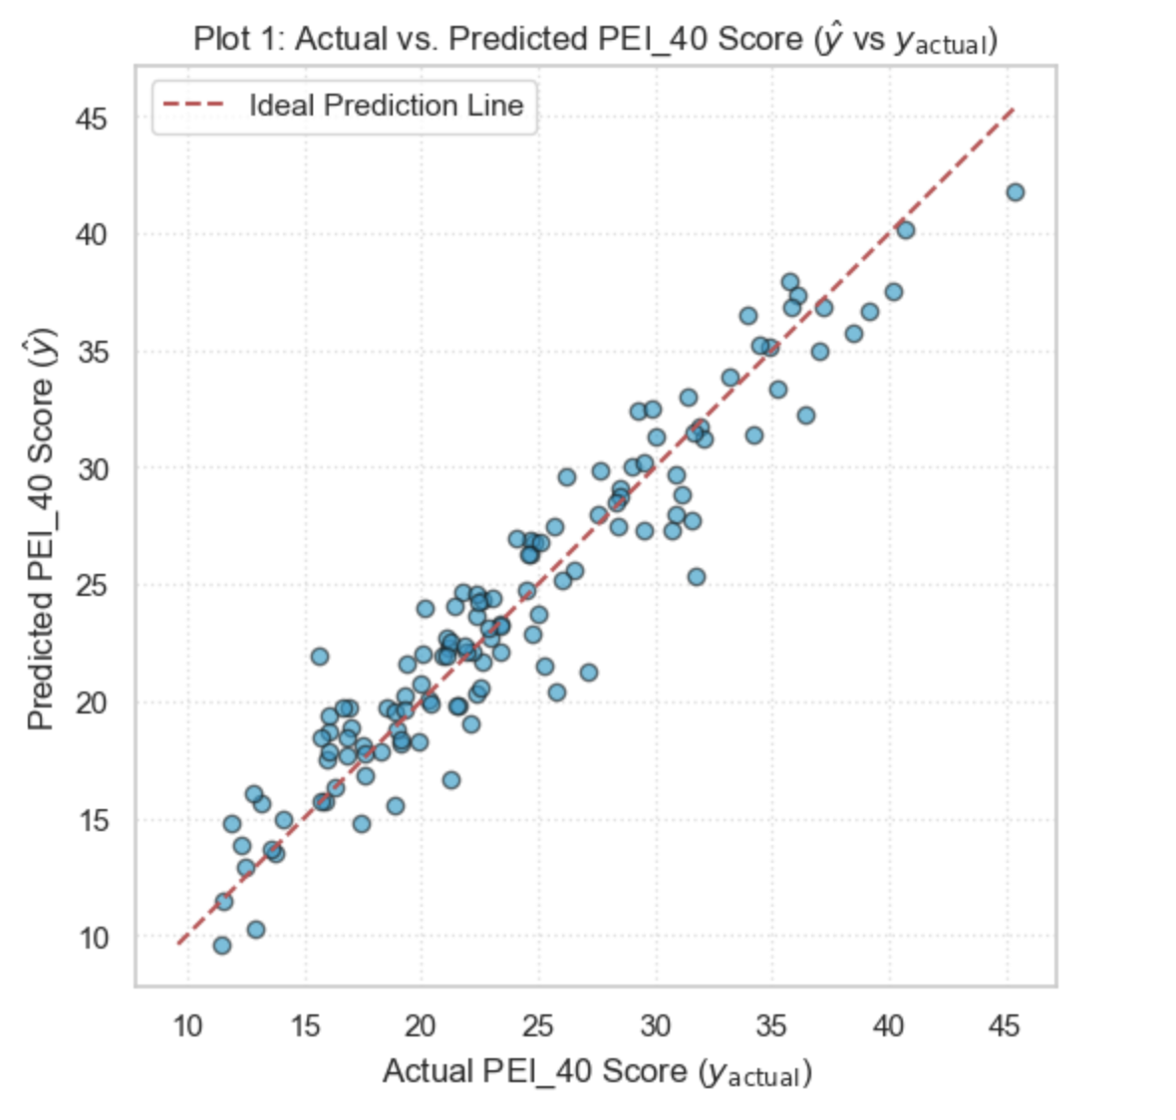
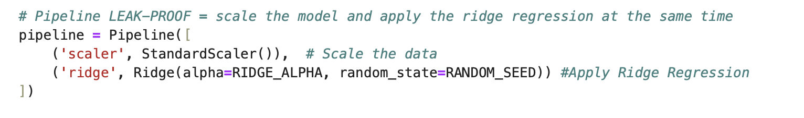
MODEL PERFORMANCE & VALIDATION
R-SQUARED SCORE
>
Our Ridge Regression model explains 93.3% of the variance in player efficiency.
>
Leak-Proof Pipeline: Scaling was applied inside the cross-validation loop to ensure no data leakage.
>
Residual Analysis: Errors are randomly distributed (MSE = 3.99), confirming the model is unbiased.
Tight clustering along the diagonal indicates high accuracy.

Slide 9
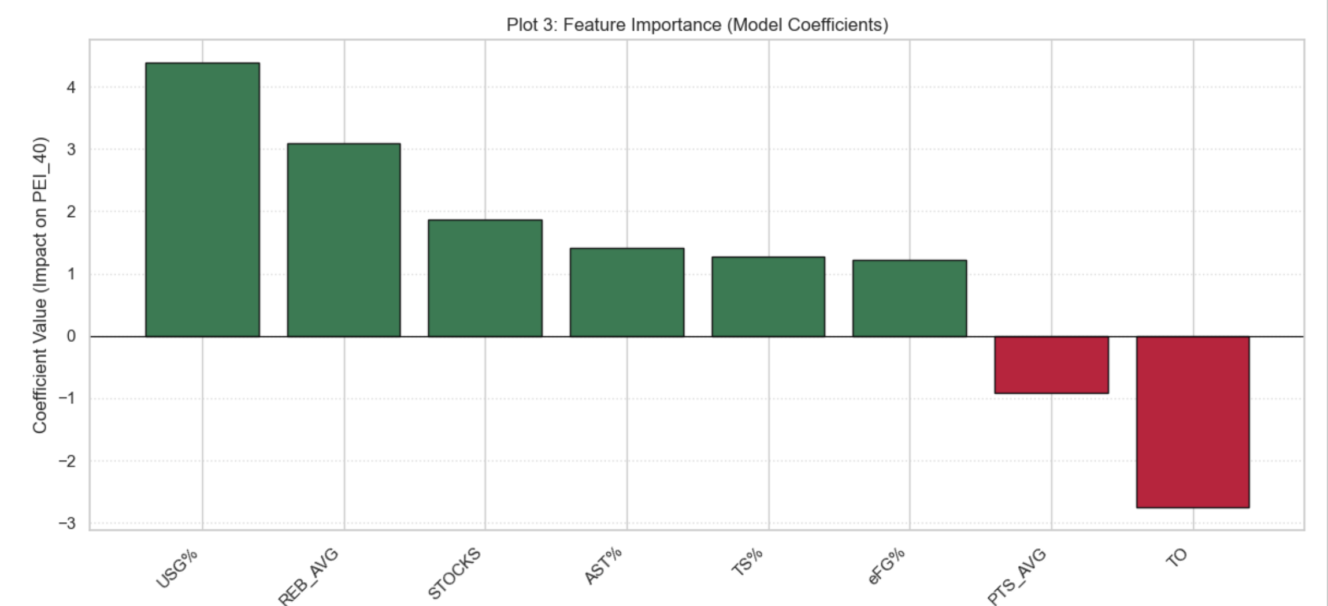
KEY INSIGHT: WHAT DRIVES VALUE?
THE "MONEYBALL" DISCOVERIES
>
USG% (+4.39): The single biggest driver. We need players who demand the ball and produce.
>
Rebounding (+3.09): Board work is undervalued. High rebounders contribute to the PEI.
>
Turnovers (-2.76): The silent killer. High turnovers negate high scoring.
>
PTS_AVG (-0.90): Confirming what the NBA knew. Pure volume scoring has a negative weight when efficiency is accounted for.

Slide 10
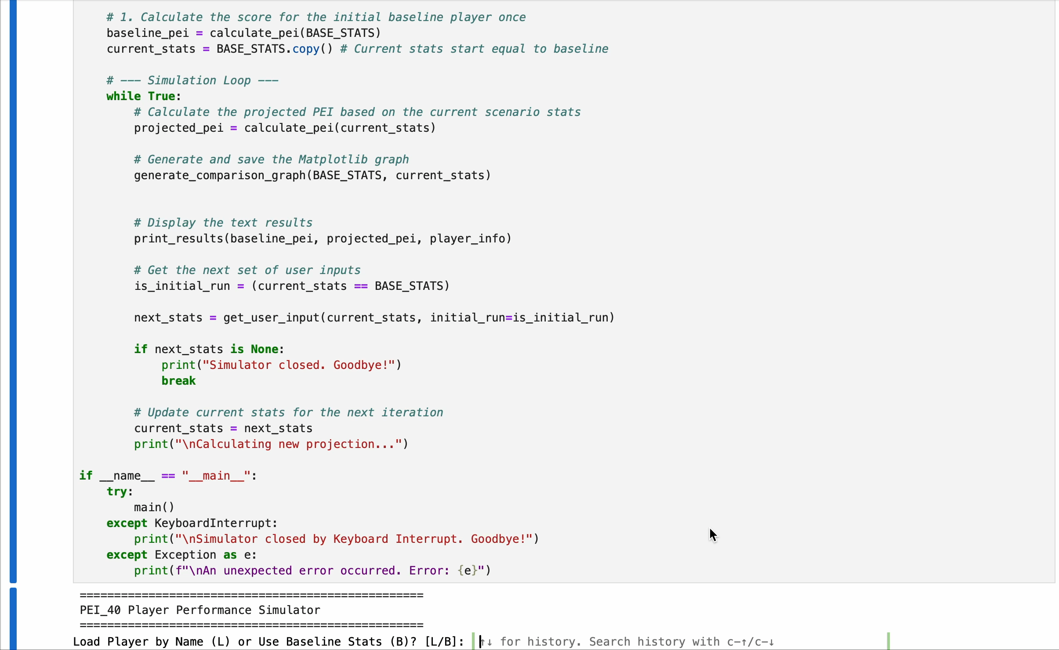
DELIVERABLE 3: SCENARIO SIMULATION
THE "WHAT-IF" ENGINE
We built an interactive Python tool to simulate player development scenarios. This moves us from predicting value to creating it.

Slide 11
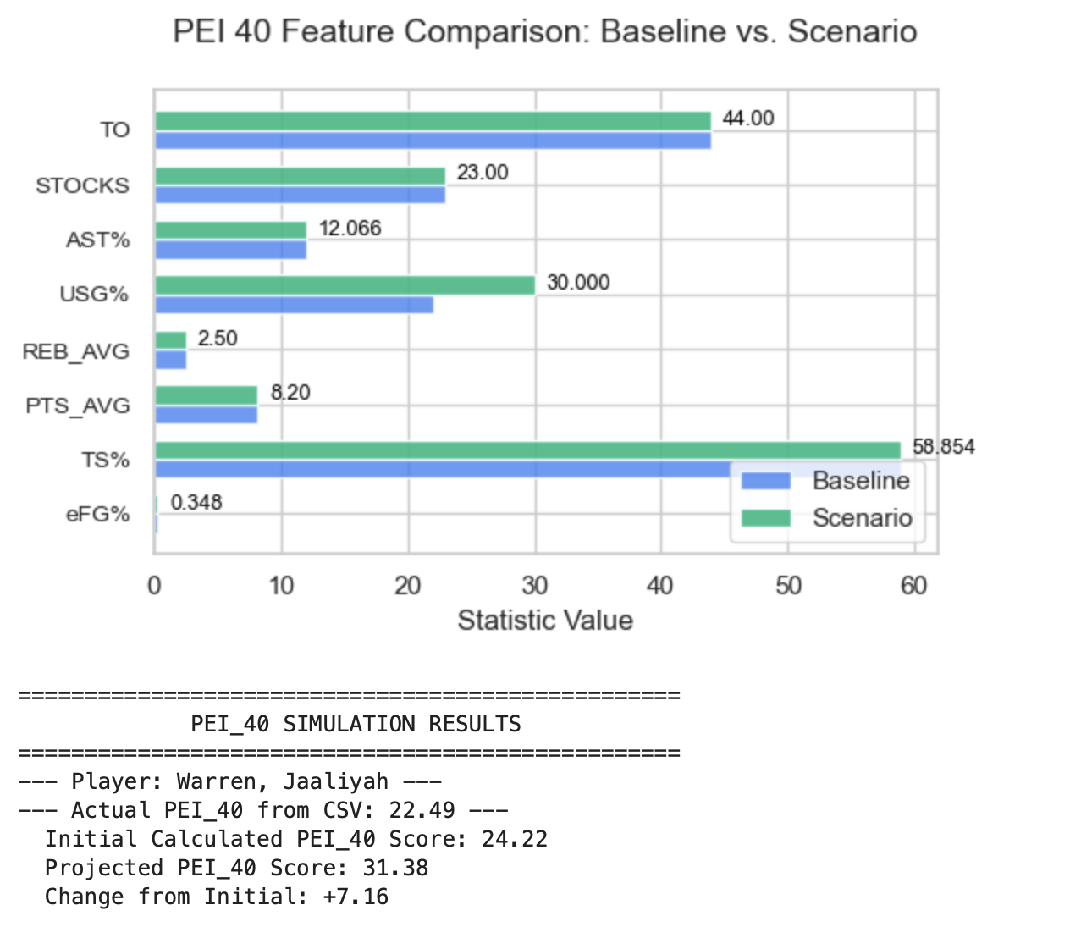
SCENARIO 1: INCREASING THE USG% OF THE 3RD HIGHEST TS%

Slide 12
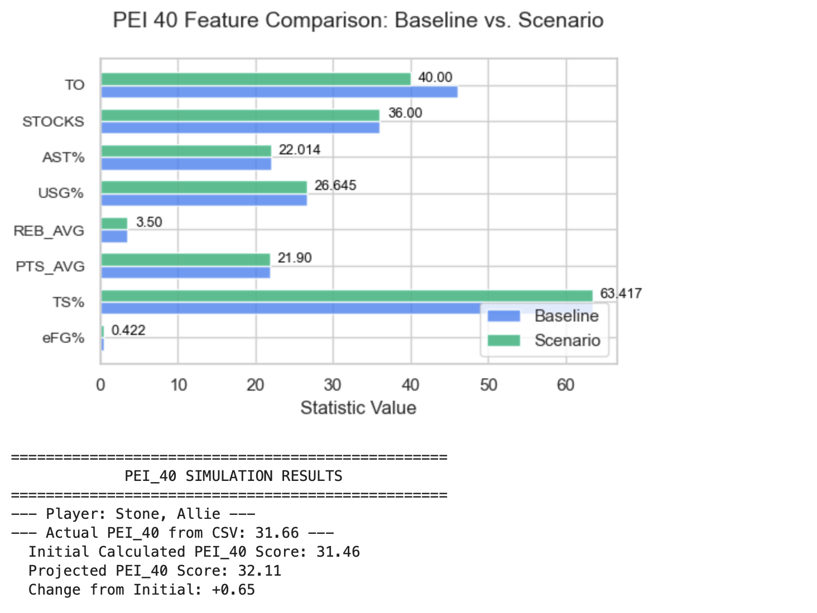
SCENARIO 2: DECREASING THE TO FOR THE HIGHEST TS%

Slide 13
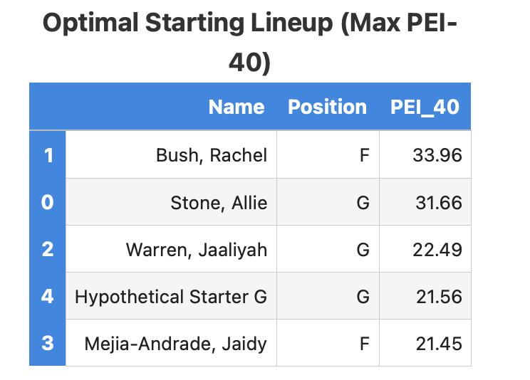
DELIVERABLE 4: LINEUP OPTIMIZATION
Using predicted PEI_40 to construct the mathematically optimal starting 5.

Slide 14




THE 5-YEAR STRATEGIC PLAN
YEAR 1
YEAR 2-3
YEAR 4-5
YEAR 5+
Audit
Develop
Recruit
Dominate
Calculate PEI_40 for full roster. Identify inefficiencies.
Use Simulator to set specific training goals (e.g., -1.5 TOV).
Target freshman/transfers with high USG% and low TOV based on model weights.
Top 10 Ranking driven by algorithmic roster construction.

Slide 15
CONCLUSION
Data Quality: Cleaned and standardized a robust dataset.
Model Accuracy: Achieved 93% accuracy with Ridge Regression.
Actionable Insight: Identified Turnovers and Usage as key levers.
Strategic Value: Created a reproducible tool for roster decisions.
QUESTIONS?

